Slide 1

Università degli Studi di Palermo
Facoltà di Ingegneria - Corso di Laurea in Ingegneria Informatica
TESINA DI ROBOTICA COGNITIVA
PROF. ANTONIO CHELLA
PROF. ROSARIO SORBELLO
A.A. 2003/2004
Allievi:
Maggio Paolo Marcenò Leonardo Messina Antonio

Slide 2
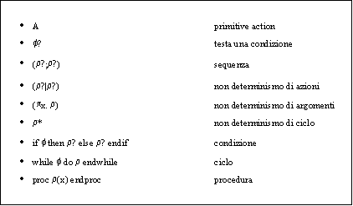
A brief look in robotics and AI theory: Part 1
The contribution of Logic Programming in modern intelligent systems
-sGolog-

Slide 3
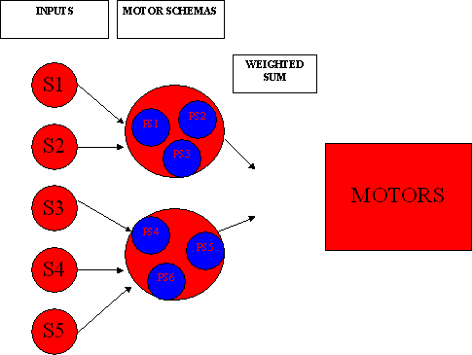
A brief look in robotics and AI theory: Part 2
Team Bots SW is based on Arkin’s MS theory

Slide 4
Productions Systems
From an architectural point of view a Productions System is composed of:
CONTROLLER
MEMORY
Match
Select
Execute
APPLICABLE
RULES
RULES

Slide 5
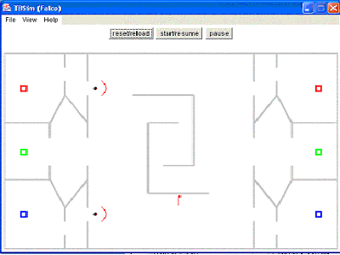
The strategy
How to deal with complex flag recovery?

Slide 6
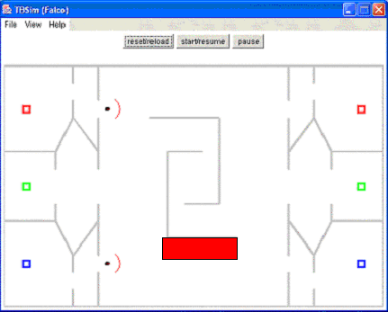
A possible way of reasoning:
1) divide the map in zones

Slide 7
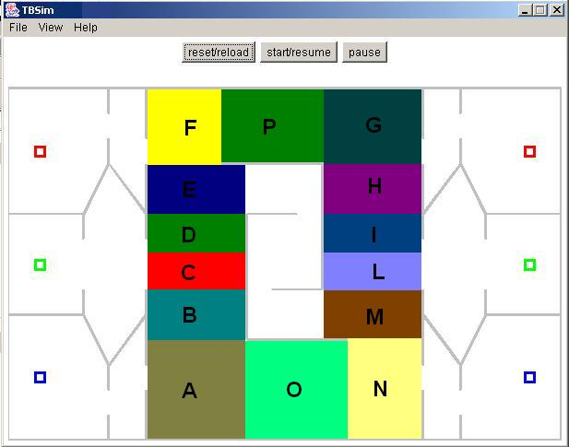
This approach foresees two zone types:
A. Robot current position

Slide 8
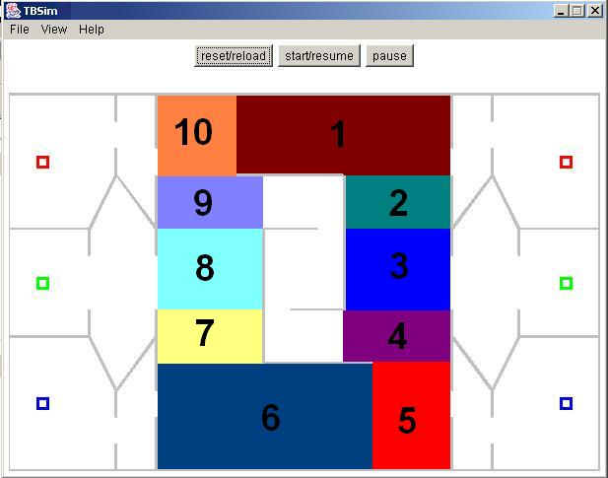
B. Flag to recover position

Slide 9
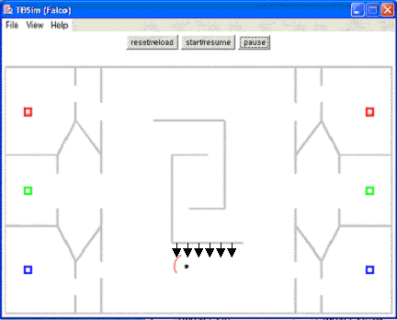
2) The robot path is influenced by a changing vector depending on the zone where the agent is currently located: Potential Fields theory provides essential support to the competition tactical approach

Slide 10
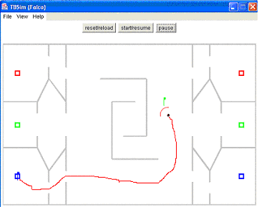
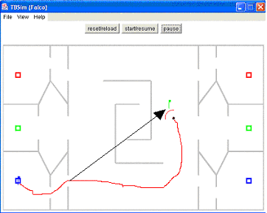
Consider now an example:
Try_it robot using zone depending potential fields
Vs
MFN150 Explore path

Slide 11
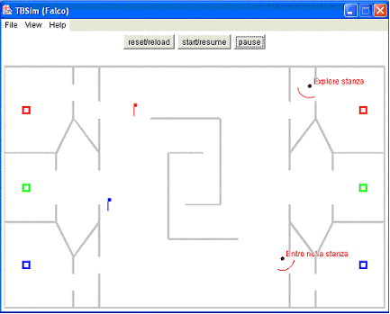
Room Exploration
Planned Exploration on:
No flag in memory, close to room entry.
Fixed time to explore connected to room dimension.
Exploration takes place whenever a detected flag is located in a room
All the rooms in the map are to be visited

Slide 12
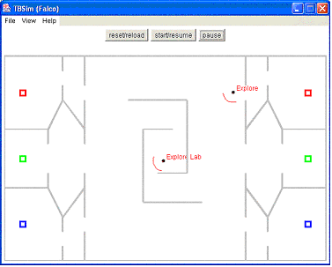
Labyrinth Exploration
Exploration on:
No flag in memory, close to lab entry;
This phase is not limited neither by a fixed time to explore, nor by a planned visits number
Try_it robot visiting lab
Continue…

Slide 13
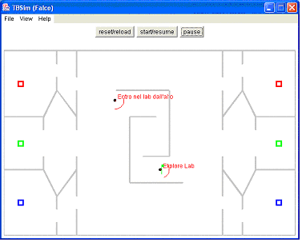
Labyrinth Exploration
Furthermore a visit occurs every time the robot enters the lab:
Flag detected;
Shortest path to homebase.

Slide 14
Messages exchange
The robot implements a three message type communication:
Message “Bandiera nuova”
Message “Delete flag”
Message “Pronto”
Messages a-b let robot memories to be updated
Message c influences robot behaviour when bringing flags

